Slide 1

Sanjivani College of Engineering, Kopargaon-423603
Sanjivani Rural Education Society’s
(An Autonomous Institute Affiliated to Savitribai Phule Pune University, Pune)
NAAC ‘A’ Grade Accredited
Department of Information Technology
(UG program, NBA Accredited)
Software Engineering Modeling & Design
“Learning Management System”
Course Incharge: Dr. S. N. Gunjal
Class : SY IT B

Slide 2

Group Members :
Roll No. | PRN | Name
75 | 0124UITF1075 | Jadhav Supriya Dadasaheb
76 | 0124UITM1076 | Nagthane Viresh Sunil
77 | 0124UITM1077 | Sinare Manav Ravindra
78 | 0124UITM1078 | Bohat Swayam Manoj

Slide 3
Introduction :
A Learning Management System (LMS) is a software application used to manage, deliver, and track educational courses.
It helps teachers and students interact in a digital environment.
Widely used in schools, colleges, and corporate training.
Users :- Student , Teacher , Admin

Slide 4

Functional Requirements :
FR1: User Registration and Login (Student, Teacher, Admin)
FR2: Course Creation and Management
FR3: Upload and Access Study Materials (PDFs, videos)
FR4: Assignment Submission
FR5: Conduct Online Exams/Quizzes
FR6: Evaluate and Grade Assignments
FR7: View Results and Progress Reports

Slide 5

Non Functional Requirements :
NFR 1: Performance – System should load quickly and handle many users
NFR 2 : Security – User data must be protected (login authentication)
NFR 3: Usability – Easy to use interface for students and teachers
NFR 4: Reliability – System should work without crashes
NFR 5 : Scalability – Can handle increasing number of users
NFR 6 : Availability – System should be available 24/7
NFR 7 : Maintainability – Easy to update and fix issues
NFR 8 : Compatibility – Works on mobile, tablet, and desktop

Slide 6
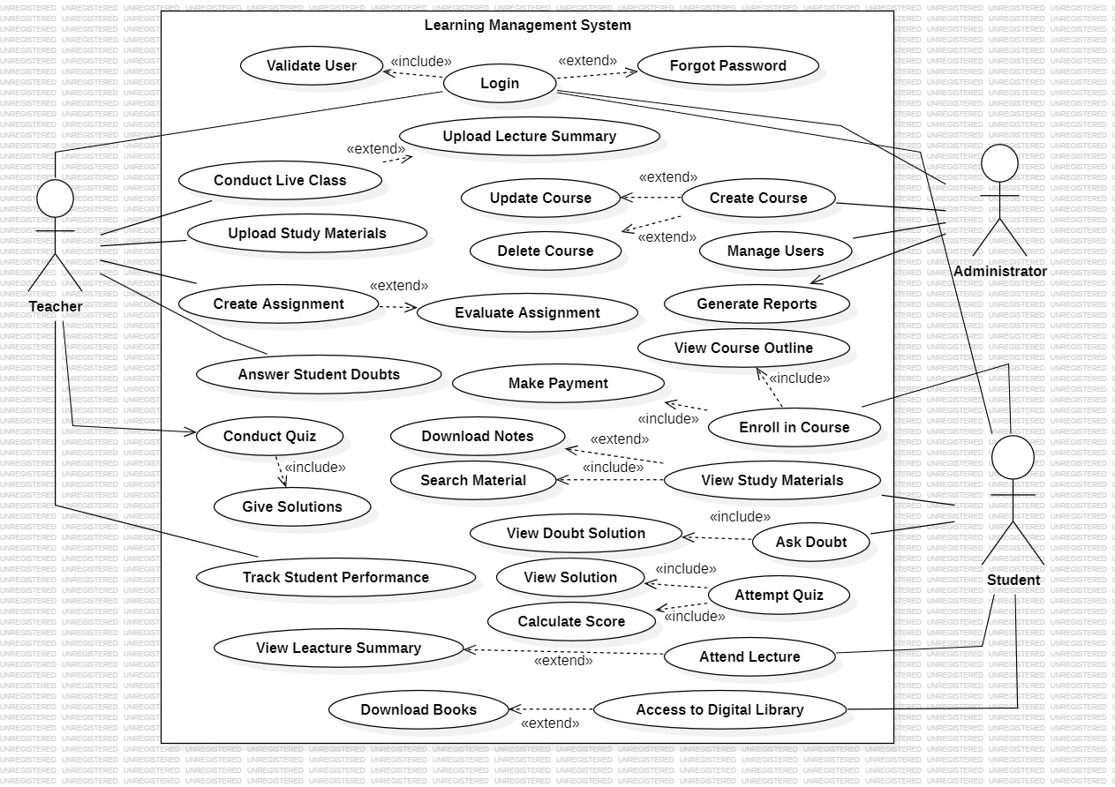
Use Case Diagram :
Components: Actors (Teacher, Student, Admin), Use Cases, System Boundary, «include» & «extend».
Interaction: Each actor performs specific tasks like teaching, learning, and managing .
Relationships: «include» = mandatory step, «extend» = optional feature.
Working: User logs in → performs role-based actions within the system.

Slide 7
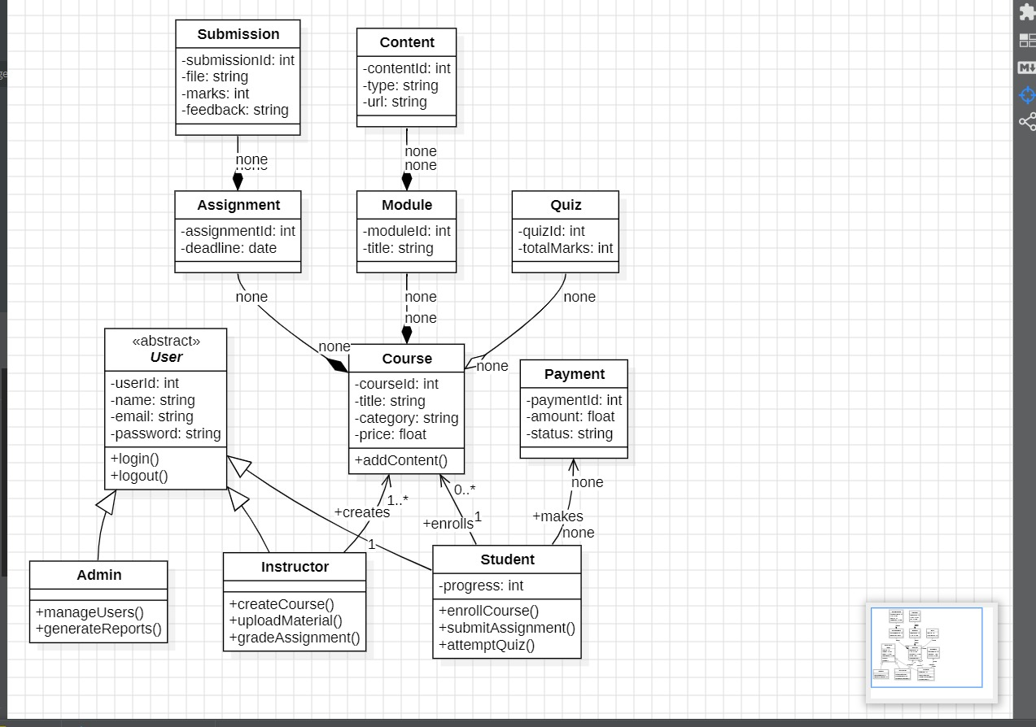
Class Diagram :
Components: Classes like User (Admin, Instructor, Student), Course, Module, Content, Assignment, Quiz, Payment, Submission
Structure: Shows attributes (data) and methods (functions) of each class
Relationships: Inheritance (User → Admin/Instructor/Student) and associations (Student enrolls, Instructor creates, etc.)
Working: System manages courses where instructors create content, students learn & submit work, and payments track enrollments

Slide 8
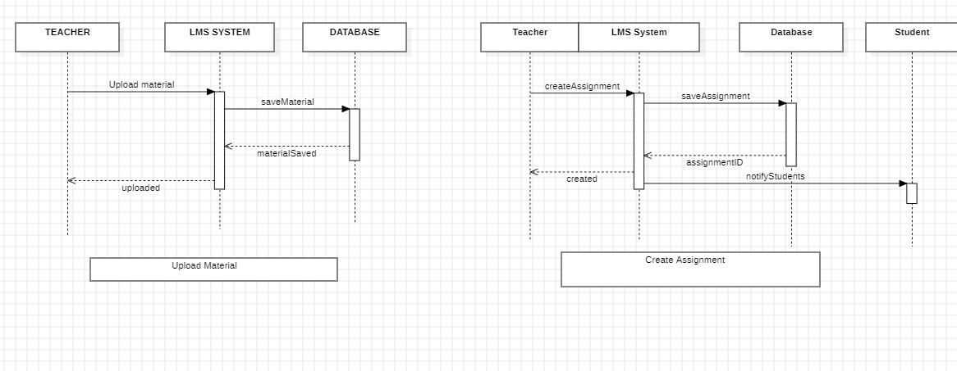
Sequence Diagram –
Components Used: The diagram includes Teacher, LMS System, Database, and Student, showing how they interact in the system.
Upload Material Flow: Teacher uploads material → LMS processes it → Database stores it → confirmation is sent back to Teacher.
Create Assignment Flow: Teacher creates assignment → LMS saves it in Database → assignment ID is generated → students are notified.
Working Principle: It is a sequence diagram that shows step-by-step communication between components using messages over time

Slide 9
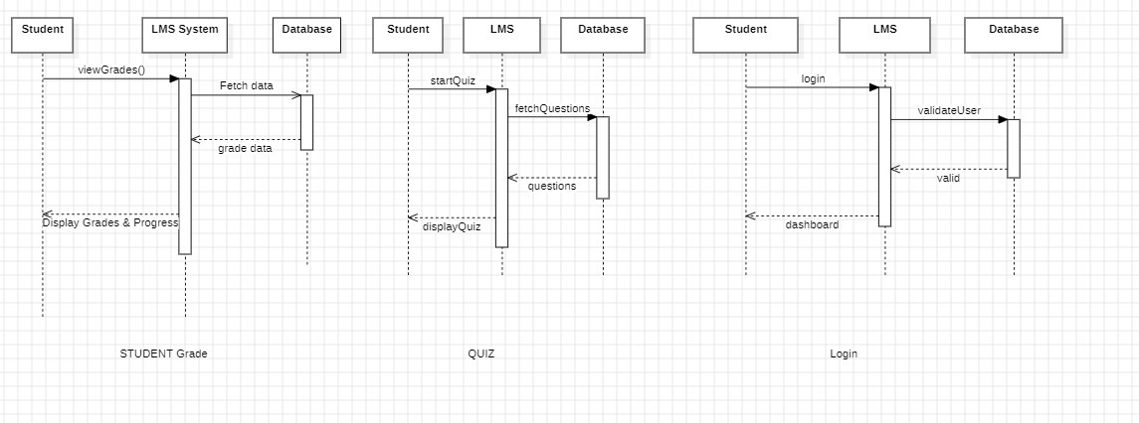
Sequence Diagram –
Components Used: The diagram shows Student, LMS System, and Database interacting for different functions (Grades, Quiz, Login).
View Grades Flow: Student requests grades → LMS fetches data from Database → grade data is returned → LMS displays grades & progress.
Quiz Flow: Student starts quiz → LMS requests questions from Database → questions are returned → quiz is displayed to student.
Login Flow: Student logs in → LMS validates user from Database → if valid, access is granted and dashboard is shown.

Slide 10
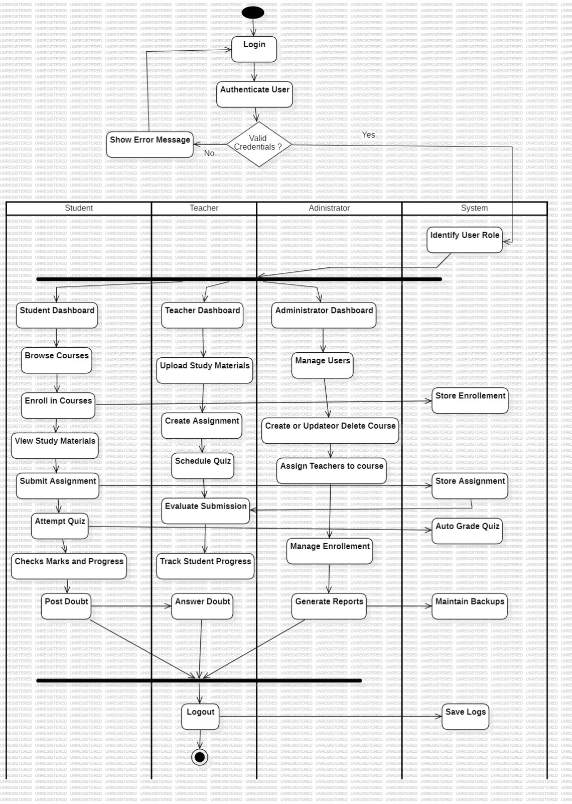
Activity Diagram :
Main Components: The activity diagram includes Student, Teacher, Administrator, and System showing different roles and their actions.
Login & Validation: User logs in → system authenticates → if credentials are invalid, an error is shown; if valid, user role is identified.
Role-Based Activities: Each user gets a dashboard—Student (learn & attempt quizzes), Teacher (upload materials & evaluate), Admin (manage users, courses, reports).
System Functions: System handles backend tasks like storing data, auto-grading quizzes, managing enrollments, backups, and logs.

Slide 11
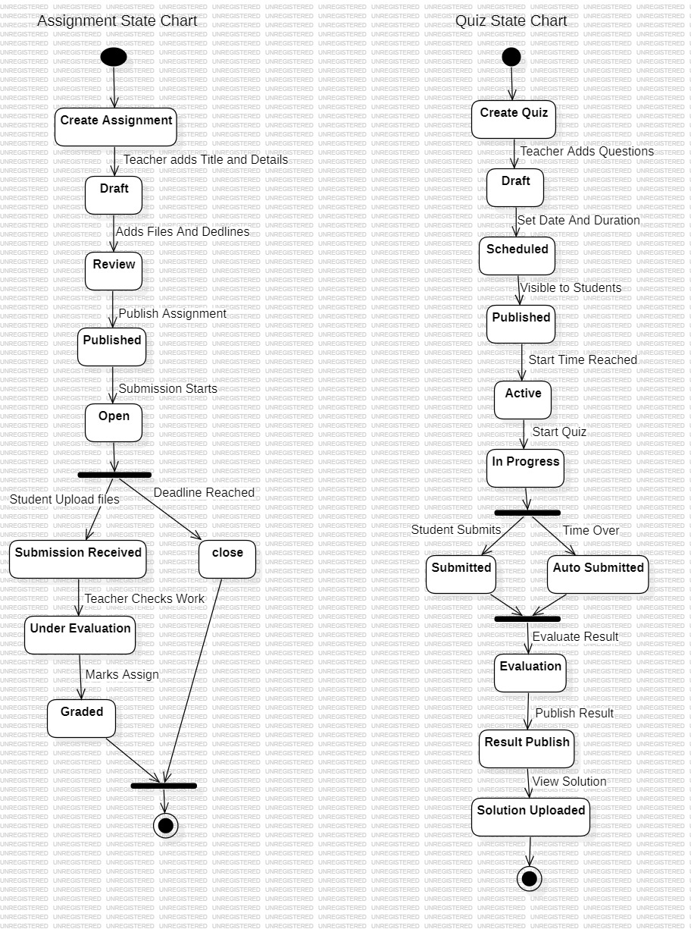
State Machine Diagram :
Two State Models: Diagram shows Assignment and Quiz state machines, representing lifecycle from creation to completion.
Assignment Flow: Starts with draft → review → published → open for submission → evaluation → graded or closed after deadline.
Quiz Flow: Created → scheduled → published → active → in progress → submitted/auto-submitted → evaluation → result published.
Working Principle: It tracks state transitions based on actions/events (like submission, deadline, evaluation) to show how tasks move step-by-step.

Slide 12
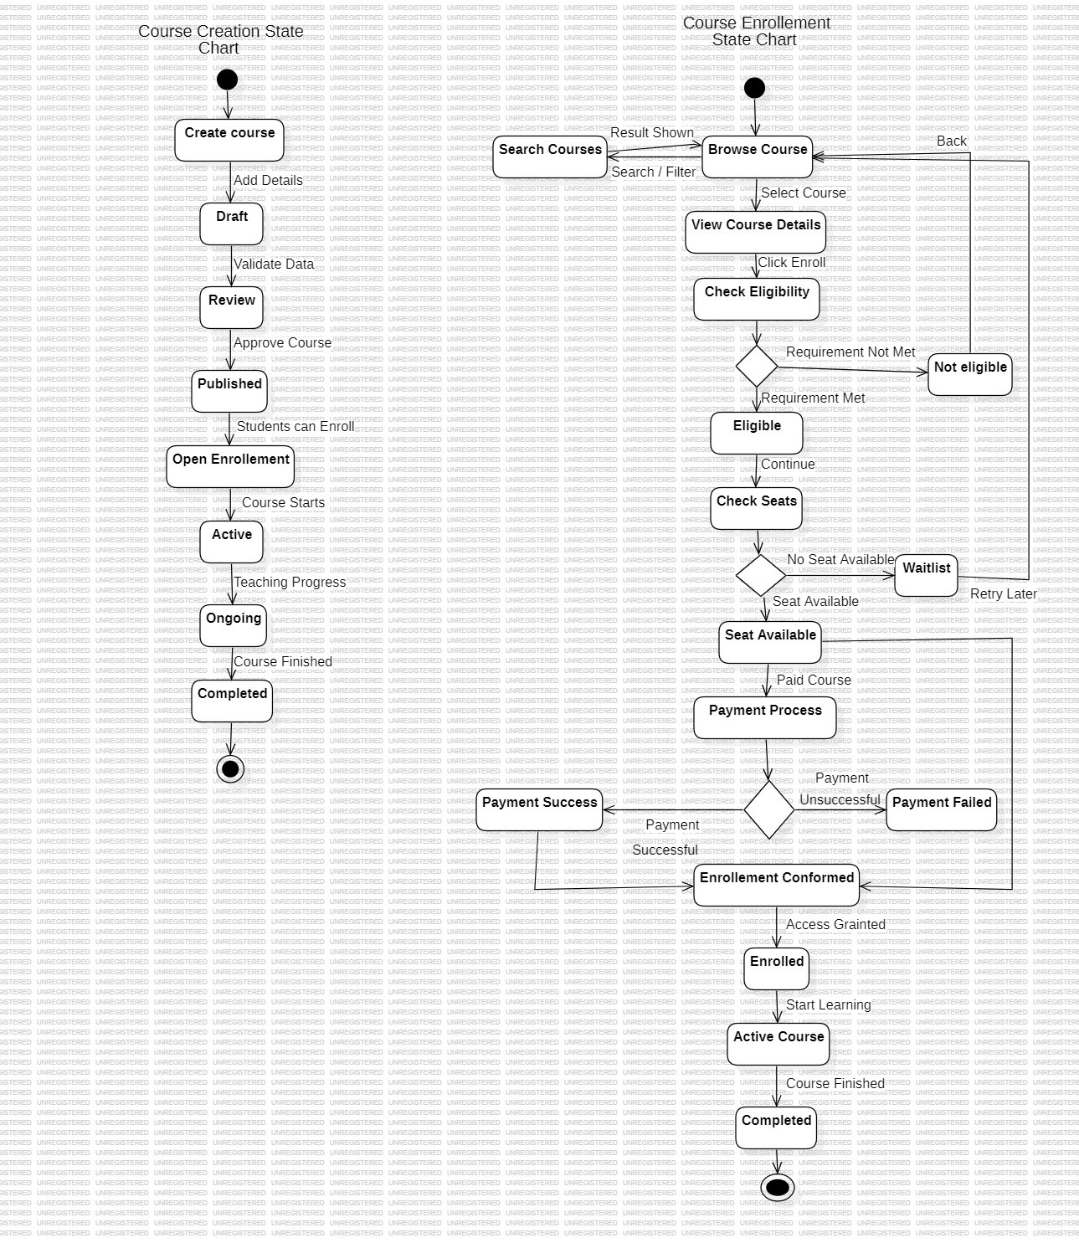
State Machine Diagram :
Course Creation Module: Shows stages from creating a course to publishing and completing it.
Enrollment Module: Describes how students browse, enroll, and complete courses.
Main Components Used: States, transitions, decision nodes, start node, and end node.
Working Process: System checks eligibility, seat availability, and payment before confirming enrollment.

Slide 13
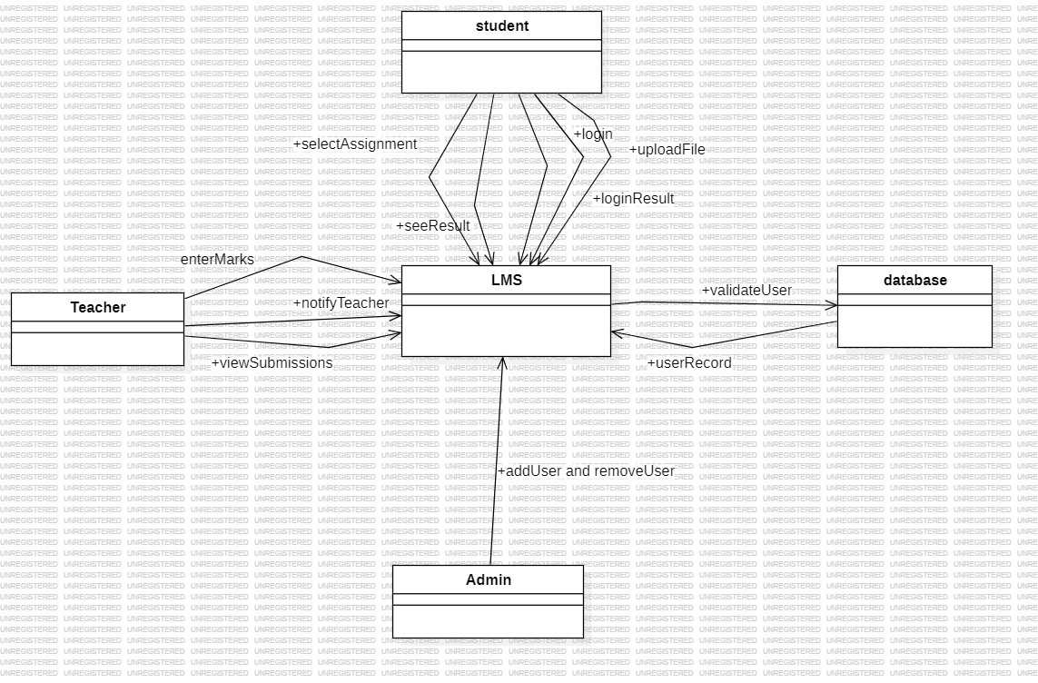
Collaboration Diagram :
Main Components: The collaboration diagram includes Student, Teacher, Admin, LMS, and Database interacting together.
Student Interaction: Student performs actions like login, upload files, select assignments, and send results through LMS.
Teacher & Admin Role: Teacher views submissions, enters marks, and gets notified, while Admin adds/removes users in the system.
System & Database Work: LMS processes all requests and communicates with Database for user validation and storing records.

Slide 14
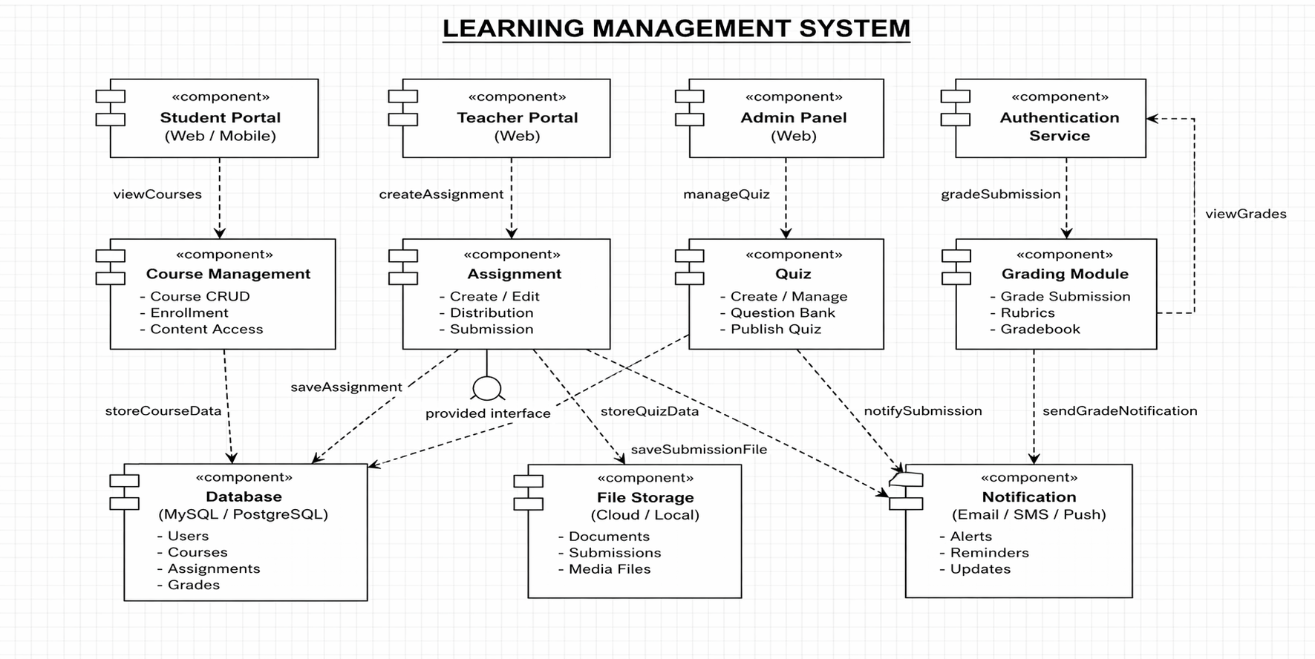
Component Diagram :
Main Components: Includes Student Portal, Teacher Portal, Admin Panel, Authentication Service, Course Management, Assignment, Quiz, Grading Module, Database, File Storage, and Notification.
User Interaction: Students view courses, Teachers create assignments, Admin manages users—all through their respective portals connected to backend components.
Core Processing: Modules like Course Management, Assignment, Quiz, and Grading handle main LMS operations and interact with Database & File Storage.
Support Services: Authentication ensures login security, while Notification system sends alerts, updates, and grade notifications to user.

Slide 15
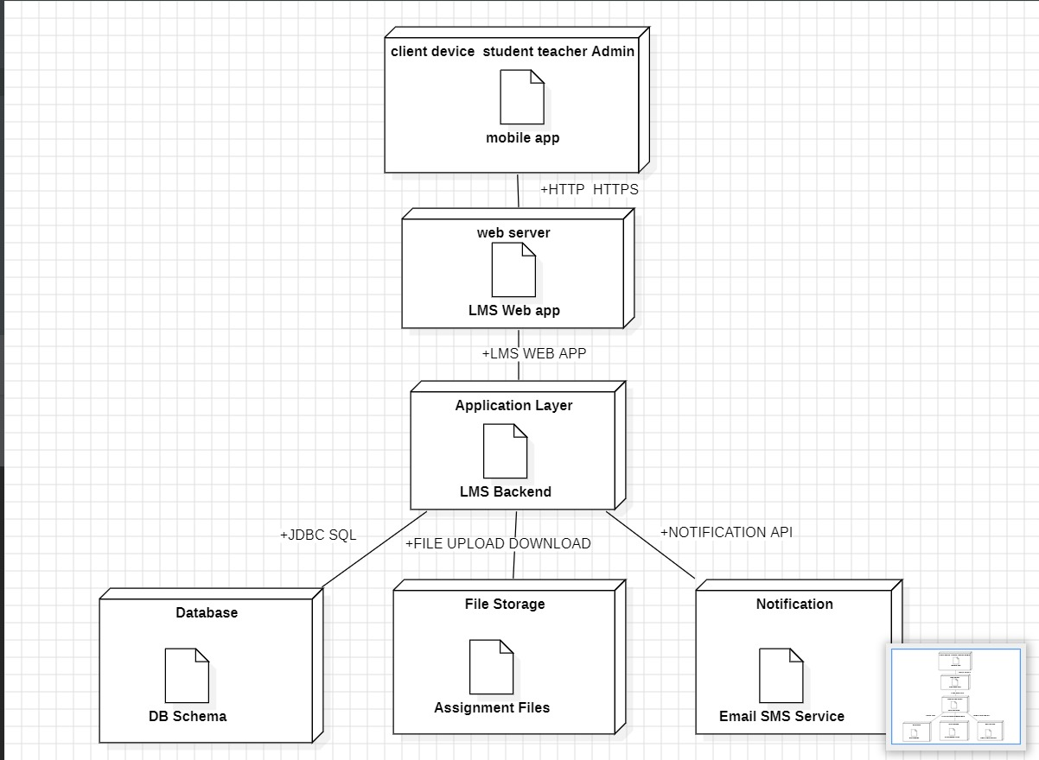
Deployment Diagram :
Deployment Layers: The system is deployed in layers—Client Device (mobile/web), Web Server (LMS app), and Application Layer (backend).
User Access: Students, Teachers, and Admin access the LMS via mobile app or browser using HTTP/HTTPS.
Backend Processing: The LMS backend handles business logic and connects to Database, File Storage, and Notification services.
External Services: Database stores data, File Storage manages uploads/downloads, and Notification service (Email/SMS) sends alerts and updates.

Slide 16
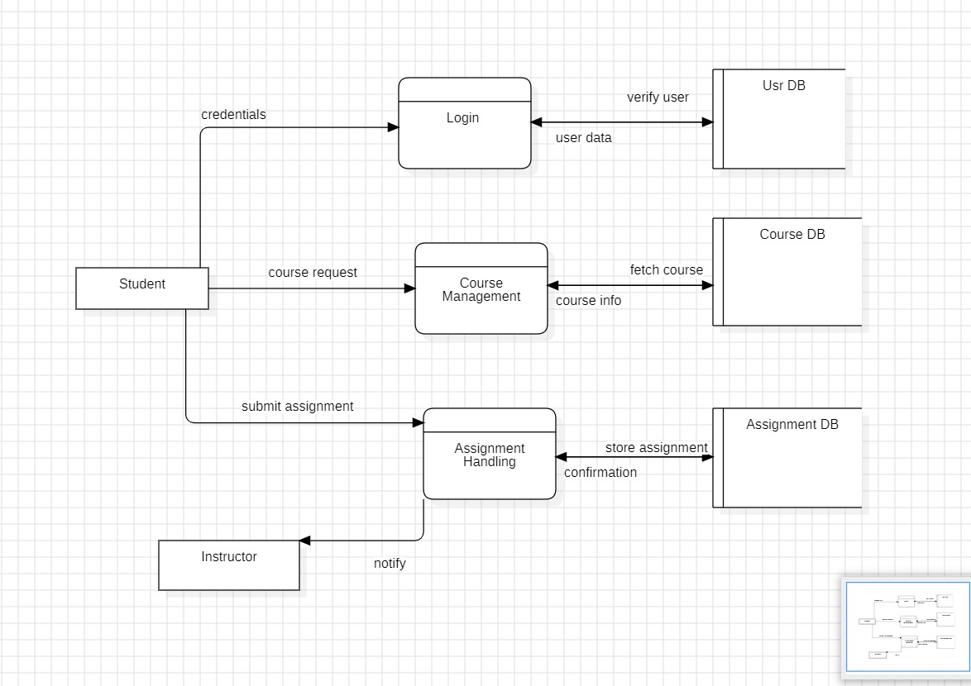
Data Flow Diagram (DFD):
Main Entities: The DFD includes Student, Instructor, Login, Course Management, Assignment Handling, and databases (User DB, Course DB, Assignment DB).
Login Flow: Student sends credentials → Login process verifies with User DB → returns user data for authentication.
Course Flow: Student requests courses → Course Management fetches data from Course DB → sends course information back to student.
Assignment Flow: Student submits assignment → Assignment Handling stores it in Assignment DB → confirmation is sent and instructor is notification.

Slide 17
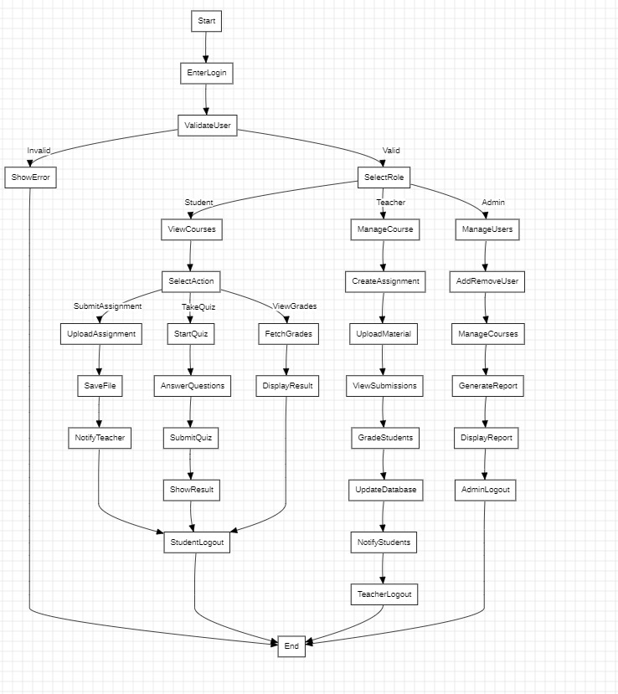
Control Flow Diagram (CFD):
Start & Validation: Process begins with login → user is validated → invalid users get an error, valid users proceed.
Role-Based Flow: After validation, system directs to Student, Teacher, or Admin based on selected role.
User Actions: Students (courses, quizzes, assignments), Teachers (create content, grade), Admin (manage users/courses, reports).
End Flow: Each role completes tasks → logs out → process ends, showing complete control flow of the system.

Slide 18
Conclusion:
The Learning Management System provides an efficient and modern solution for managing educational activities digitally. By integrating students, teachers, administrators, and learning resources into a single platform, the system ensures smooth communication, organized record management, and easy access to academic content. It reduces manual effort, saves time, and improves the overall teaching and learning process.
The inclusion of features such as online courses, study materials, assignments, quizzes, progress tracking, and digital libraries allows users to learn and manage tasks conveniently from anywhere. Teachers can effectively monitor student performance, while administrators can manage users and courses efficiently. Overall, this system promotes smart education practices and demonstrates how technology can transform traditional learning into an interactive, flexible, and intelligent system.

Slide 19
References:
1. Greek for Geeks: -
https://www.geeksforgeeks.org/systemdesign/online-learning-management-system-srs/
2. IEEE
https://ieeexplore.ieee.org/document/5492522
3. E-Learning Management System UML Diagram
https://www.freeprojectz.com/uml-diagram/e-learning-management-system-uml-diagram

